Slide 1
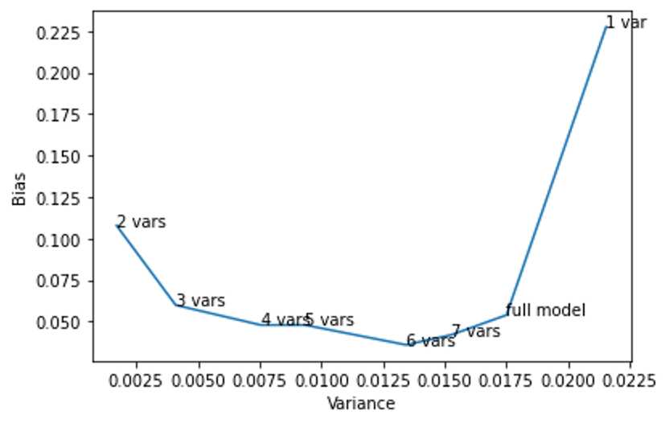
Breast Cancer Prediction with Logistic Regression
Problem
Identify the best model that can correctly classify patient’s breast cancer as benign or malignant.
Model
Logistics Regression, Lasso , Ridge
Model Selection (Accuracy, Recall)
Process
Exploratory Data Analysis
Data Transformation
Train Test Split
Check Multicollinearity
Data Modeling
Model Comparison
Model | Accuracy | Recall (Malignant Class)
Ridge Classifier | 94% | 87%
Logistic with L1 | 95% | 88.88%
Simple Logistic | 98% | 97%
Results
After cross-validation of 10 training splits, we found the best model is Logistic Regression.
Logistic model achieved an average accuracy and recall of 98% and 97% on the test data.
Logistic regression's base model is more adept at capturing the essential features impact on predicting breast cancer without the need for feature selection.
The base logistic regression model could be simpler and less prone to overfitting than L1 or L2 regularized models.
The regularization techniques might not effectively handle noise or irrelevant features in the dataset

Slide 2
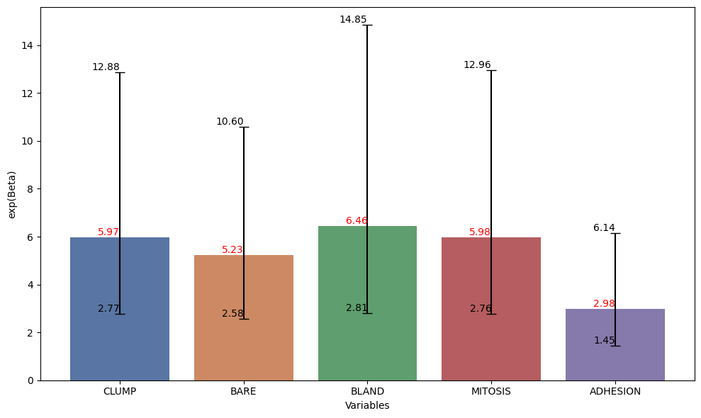
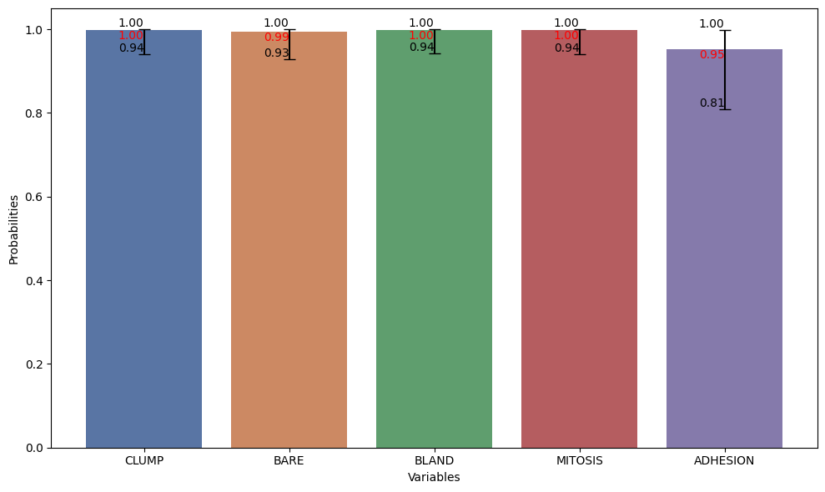
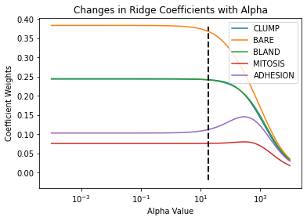
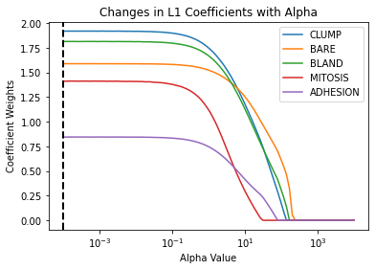
With a small training dataset, there's a risk that the model might not capture the full complexity of the problem. Although our final subset excludes cell shape and size features, these attributes might hold valuable information. Higher accuracy due to data imbalance might lead to misleading conclusions.
Regularization in Breast Cancer Prediction
Parameter Selection: Alpha Optimization
Approach
Cross-validation (RidgeCV and LassoCV) to identify the best alpha values 17.88 and 0.0001 for regularization respectively.
Key Takeaways:
Alpha Range
Defined a spectrum of alpha values to train models and observe coefficient variation.
For instance, a unit increase in the values of BLAND, CLUMP, or MITOSIS is associated with a higher likelihood of the predicted outcome (malignant) by approximately 6.45, 5.96, and 5.98 units, respectively.”
On comparison of the Logistic regression, L1, L2 models, we can observe that the Base model is able to perform much better due to reasons such as the data might have features where L1 regularization's sparsity or L2 regularization's coefficient shrinkage does not significantly improve predictive performance.
All variables have relatively wide confidence intervals (significant uncertainty) for their coefficients, suggesting variability or potential instability in the estimated effects.
Outcome
Selected the alpha that minimized the Mean Squared Error (MSE) and maximized R².
Limitations:

